Slide 1
TimeClock Plus
Part Time Employees

Slide 2
Biggest Changes:
For biometric clock, no longer last SS#’s, now numbers in Employee A#, without the letter A and without the leading zero’s, just numbers
Biometric clock will accept 2 fingerprints. No need to use both, just one.
For logging into Web access using computer, use same credentials as computer login. Linked to one user one password.
All punches are immediately posted in system.
Select proper action such as IN and OUT, not just enter as with TimeForce.
The new clocks allow employees to read messages from supervisors, and review and verify hours.

Slide 3
Contents
Clocking in and out operations – using the Timeclock
Missed punches – using the Timeclock
Messages – using the Timeclock
Approving Time – using the Timeclock
Clocking in and out operations – using the computer (webclock)
Missed punches – using the computer (webclock)
Best Practices

Slide 4
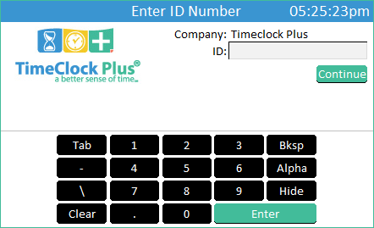
Clocking in and out operations
Using the touchscreen keypad, enter your Employee A#, not including the leading zeros.
Press

Slide 5
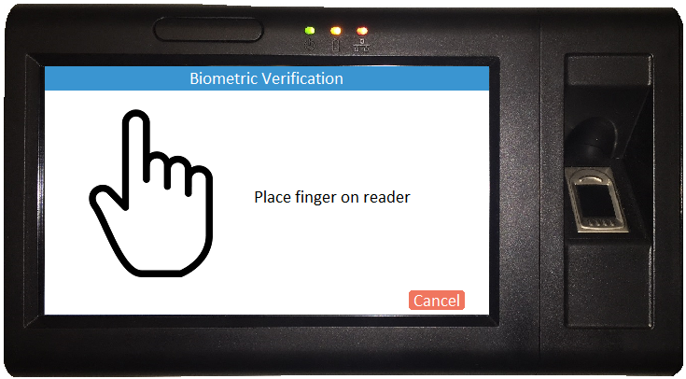
Clocking in and out operations
Place your finger on the fingerprint scanner.

Slide 6
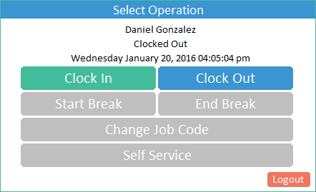
Clocking in and Clocking Out Operations
To Clock In:
Select
To Clock Out:
Select
Only use the Clock In and Clock Out options.
Do not clock out for breaks.
DO NOT USE Logout tab on bottom right corner for Clocking Out.
This will completely log you out of the system.

Slide 7
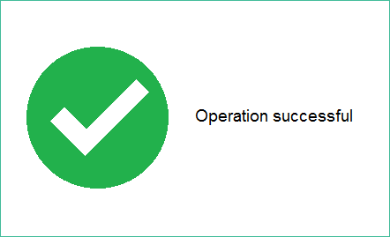
Clocking in and out (Biometric Reader)
When you see this screen, you have successfully clocked in/out.

Slide 8
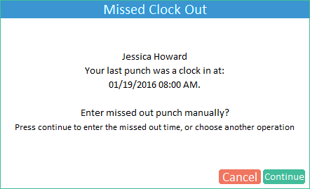
Missed Punch – Enter Record
The date and time shown is your
last punch.
Press

Slide 9
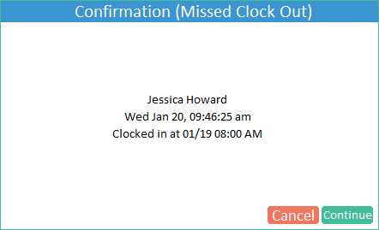
Missed Punch – Enter Record
Confirm information on the screen is correct Press Continue to enter the missing punch.

Slide 10
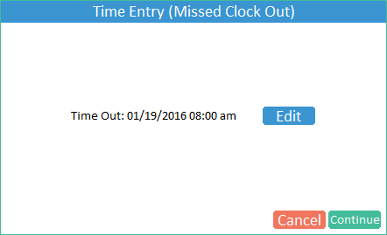
Missed Punch – Enter Record
Press

Slide 11
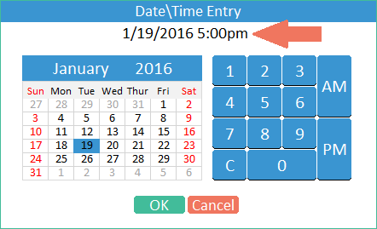
Missed Punch – Enter Record
Ensure the correct date is selected, then use the keypad to enter the time of the missed punch.
Press

Slide 12
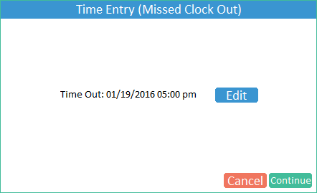
Missed Punch – Enter Record
The correct date and time of the miss punch should be displayed.
Press

Slide 13
Missed Punch – Enter Record
The correct IN and OUT punches for the day should be displayed.
Press

Slide 14
Basic Clock Operations (Scanner)
When you see this screen, you have successfully clocked in/out.

Slide 15
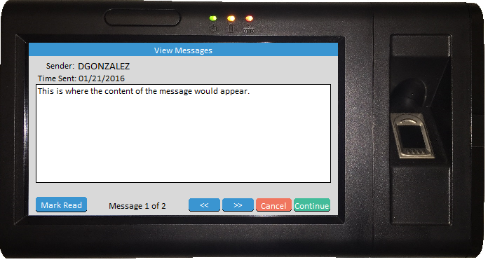
Employee Message
The buttons are used to scroll through the messages but will only appear if there are multiple messages available to view.
The button alerts the sender that you have viewed the message. Upon marking a message as read, it will immediately advance to the next message. The sender may not require the alert in which case the button may not appear.
You must press to finish clocking in or out.

Slide 16
Approving Time
Log into the clock. This will take you to the “Select Operation” screen.
From the “Select Operation” screen, press
Do not use any function outside of punching in/out/resolving missed punch, on the clock during the hours of:
7:30 – 8:30 am and 4:30-5:30 pm.
This is to avoid delaying others during the hours of peak timeclock use.

Slide 17
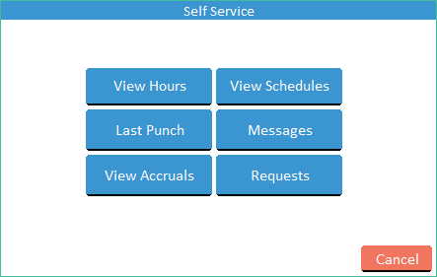
Approving Time
On the “Self Service” screen, press

Slide 18
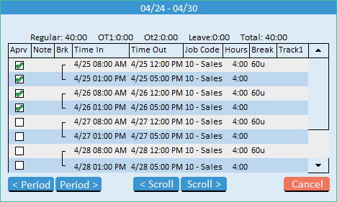
Approving Time
Examine the time information. If everything is correct, press the Checkbox in the Aprv column next to the segment.

Slide 19
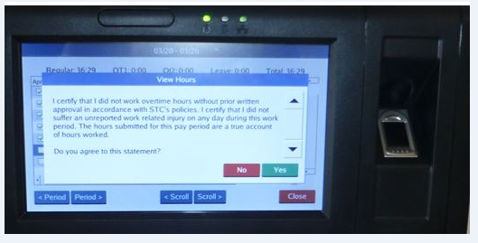
Approving Time-Certification
Every time you approve your hours, you will receive this notice. It is the same certification as in our previous timekeeping system.
If you agree to this statement, click on Yes.

Slide 20
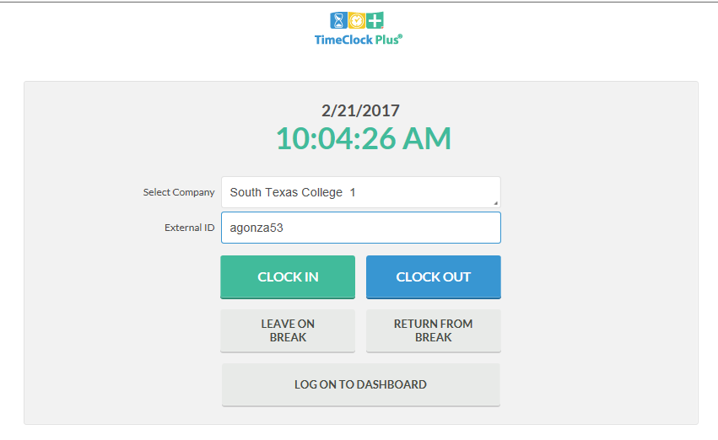
Clock in and Out using Computer (webclock)
Go to TimeClock link. Login using your computer credentials. Click CLOCK IN or CLOCK OUT.
https://tcptest1.southtexascollege.edu/app/webclock/#/EmployeeLogOn/%20/1

Slide 21
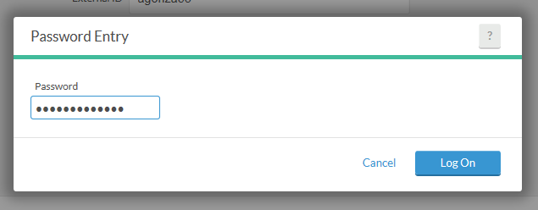
Clock in and Out using Computer
Enter your Password. Same password as computer credentials. Click Log On.

Slide 22
Clock in and Out using Computer
Go to TimeClock link. Login using your computer credentials. Click CLOCK IN or CLOCK OUT.

Slide 23
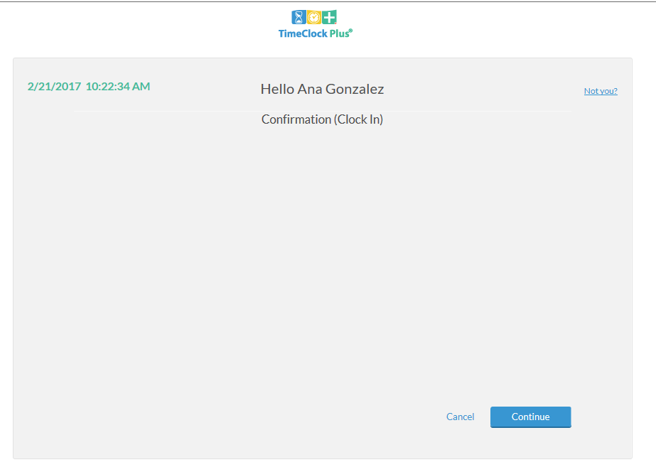
Clock in and Out using Computer
This is confirming that you are clocking in. Click on Continue.

Slide 24
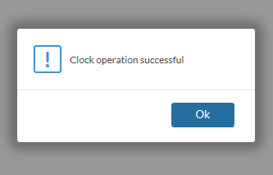
Clock in and Out using Computer
You will see the message indicating that the clock operation was successful.
Click on Ok.

Slide 25
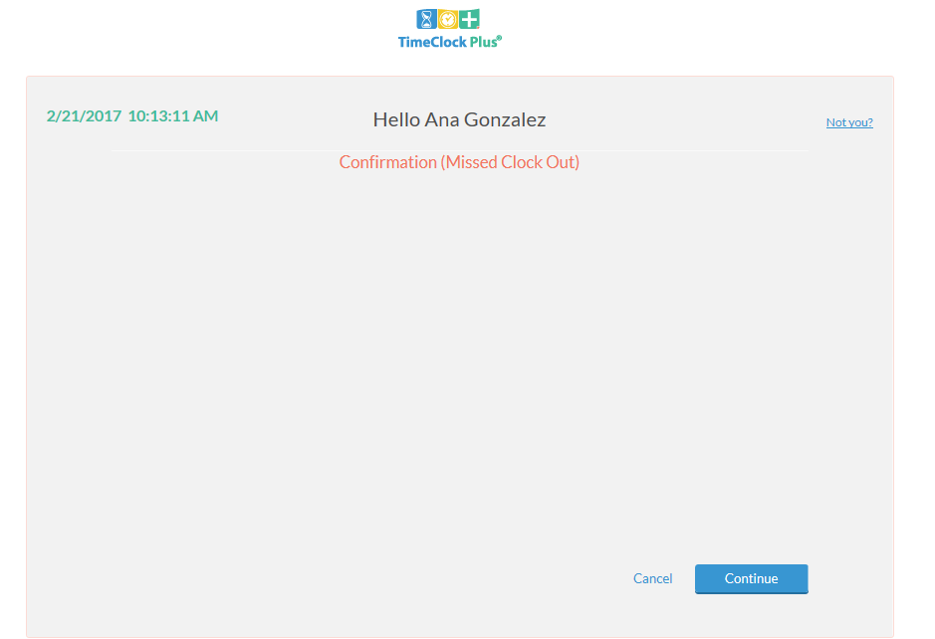
Correcting/Missing punches using Computer
If you get this message, this means you missed a punch and you cannot perform any other actions until it is corrected.
Click Continue.

Slide 26
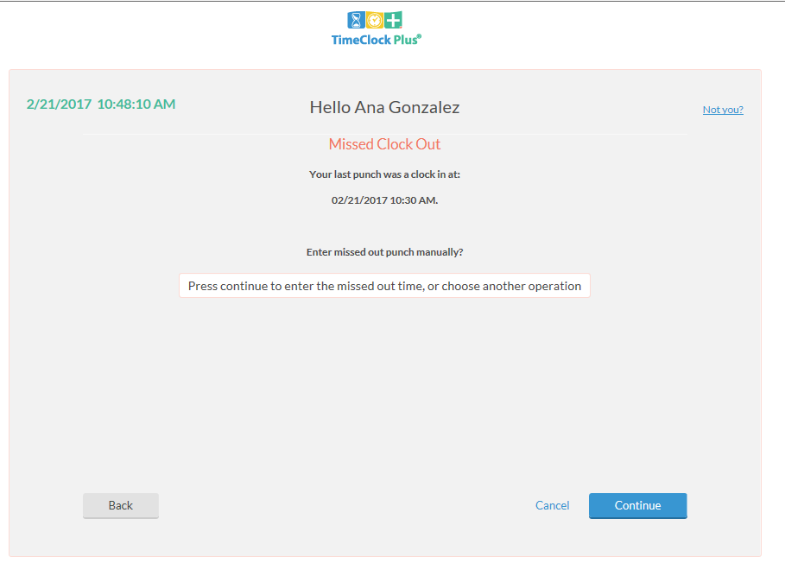
Correcting/Missing punches using Computer
The screen is asking if you want to enter missed out punch manually.
Click Continue.

Slide 27
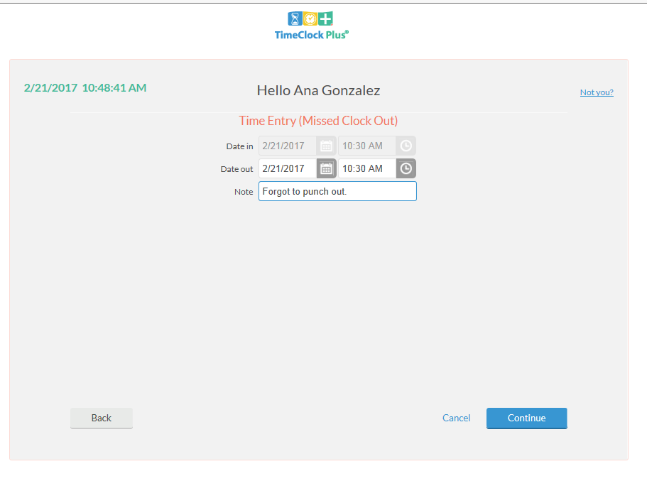
Correcting/Missing punches using Computer
Verify or enter date and time of missed punch. Enter a Note, this is required.

Slide 28
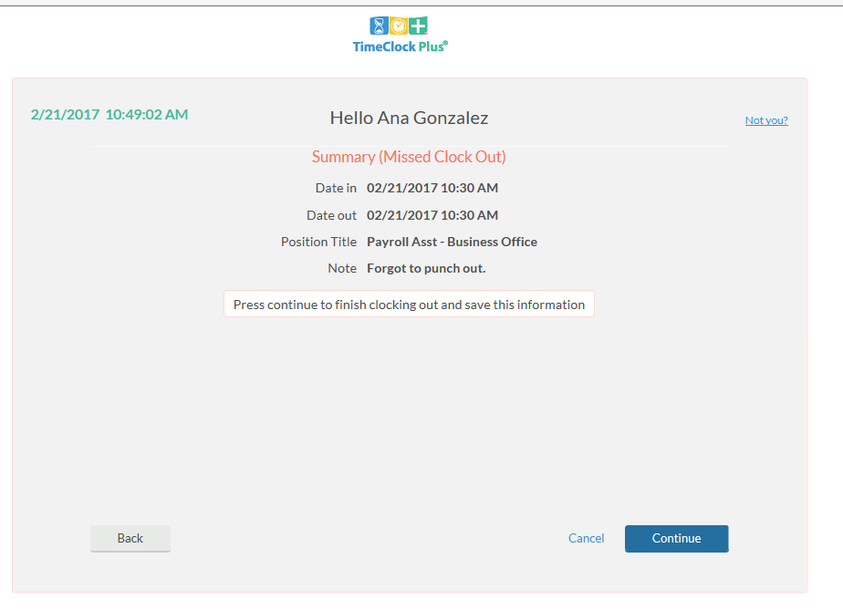
Correcting/Missing punches using Computer
Summary screen.
Verify date, time, and action.
If correct, click Continue.

Slide 29
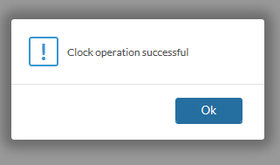
Correcting/Missing punches using Computer
You should get Clock operation successful message which means you were able to both correct the missing out punch and clock yourself in with this operation.

Slide 30
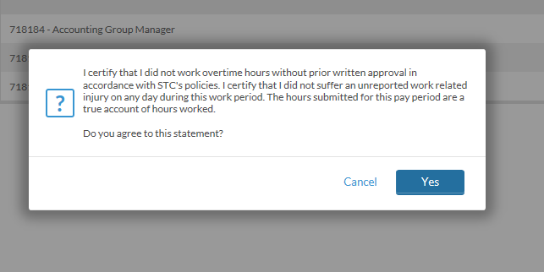
Approving Time Using Computer – Employee Certification
Every time you approve your hours, you will receive this notice. It is the same certification as in our previous timekeeping system.
If you agree to this statement, click on Yes.

Slide 31
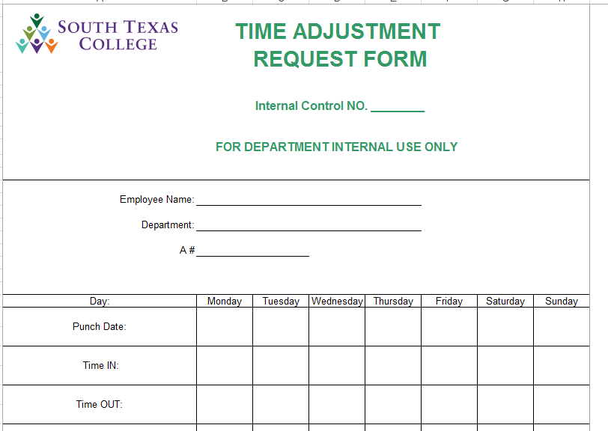
Correct/Revise Punch
If an employee forgot to punch in at 7:30 am, but remembered and punched in at 8:00 am, an adjustment needs to be made by the supervisor to reflect the correct time.
The employee will complete the Time Adjustment Request Form and turn in to supervisor for review, approval, and posting.
Keep in mind, this is should be atypical and very limited in occurrence.

Slide 32
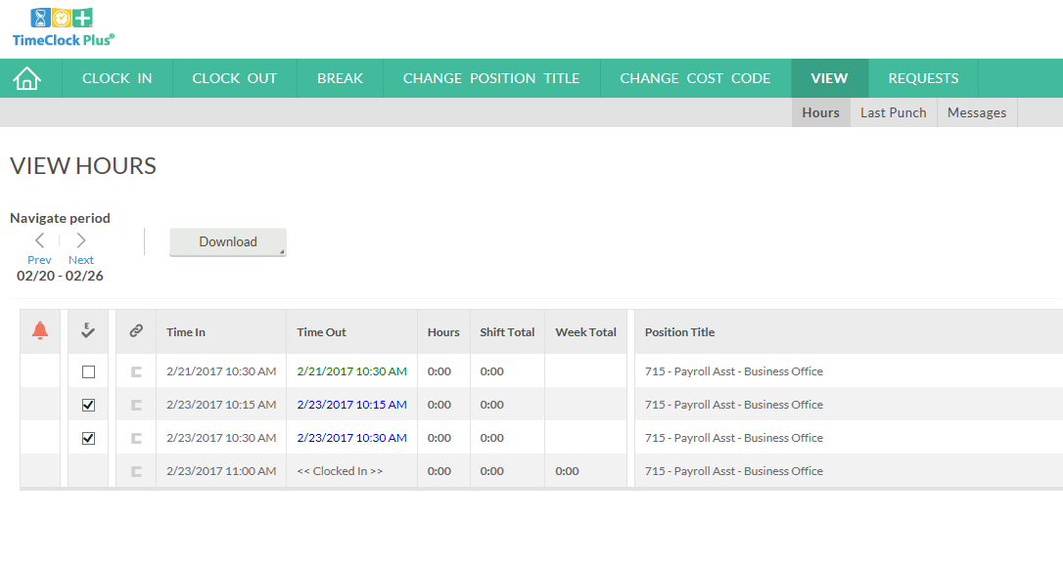
Verifying Timecard using Computer
After a completed pay period (1-15) or (16-31), go to the View tab, Hours, then click on Employee Approval column to verify your timecard for that week.

Slide 33
Best Practices
Use the TimeClock for punching in and out.
Use the Computer for reviewing and verifying timecards.
Review and approve your hours on a daily basis.
Become familiar with the software so that it can be utilized to the best capacity.
Of course, same fraud awareness carries over. Do not share passwords, do use the clock in your assigned area, do not abuse leave, do not abuse working hours, do not overuse the ability to correct/revise punches.
Any reports of suspicion of abuse will be investigated.
Visit website https://southtexascollege.edu/info/timecard/
Presentations and Training Videos

Slide 34
What to expect in May!
When you come in Monday morning, May 1st, you should use new clocks, which will be replacing old clocks at all current clock locations.
Punch in/out using your employee A #, no letter A, and no leading zero’s.
Review all hours in (TimeForce) for April. It is critical to have all hours entered into (TimeForce) accurately as we will be closing the month on May 2nd.
Let us know of anything that needs our attention.
For supervisors, we will be conducting lab training for producing reports, setups, etc.
If supervisor, make sure you have access to all your employees in new system.
Do not leave until we scan your fingerprints in new timeclock. (non-exempt employees)

Slide 35
Thank you!
TimeClock Plus

